Slide 1
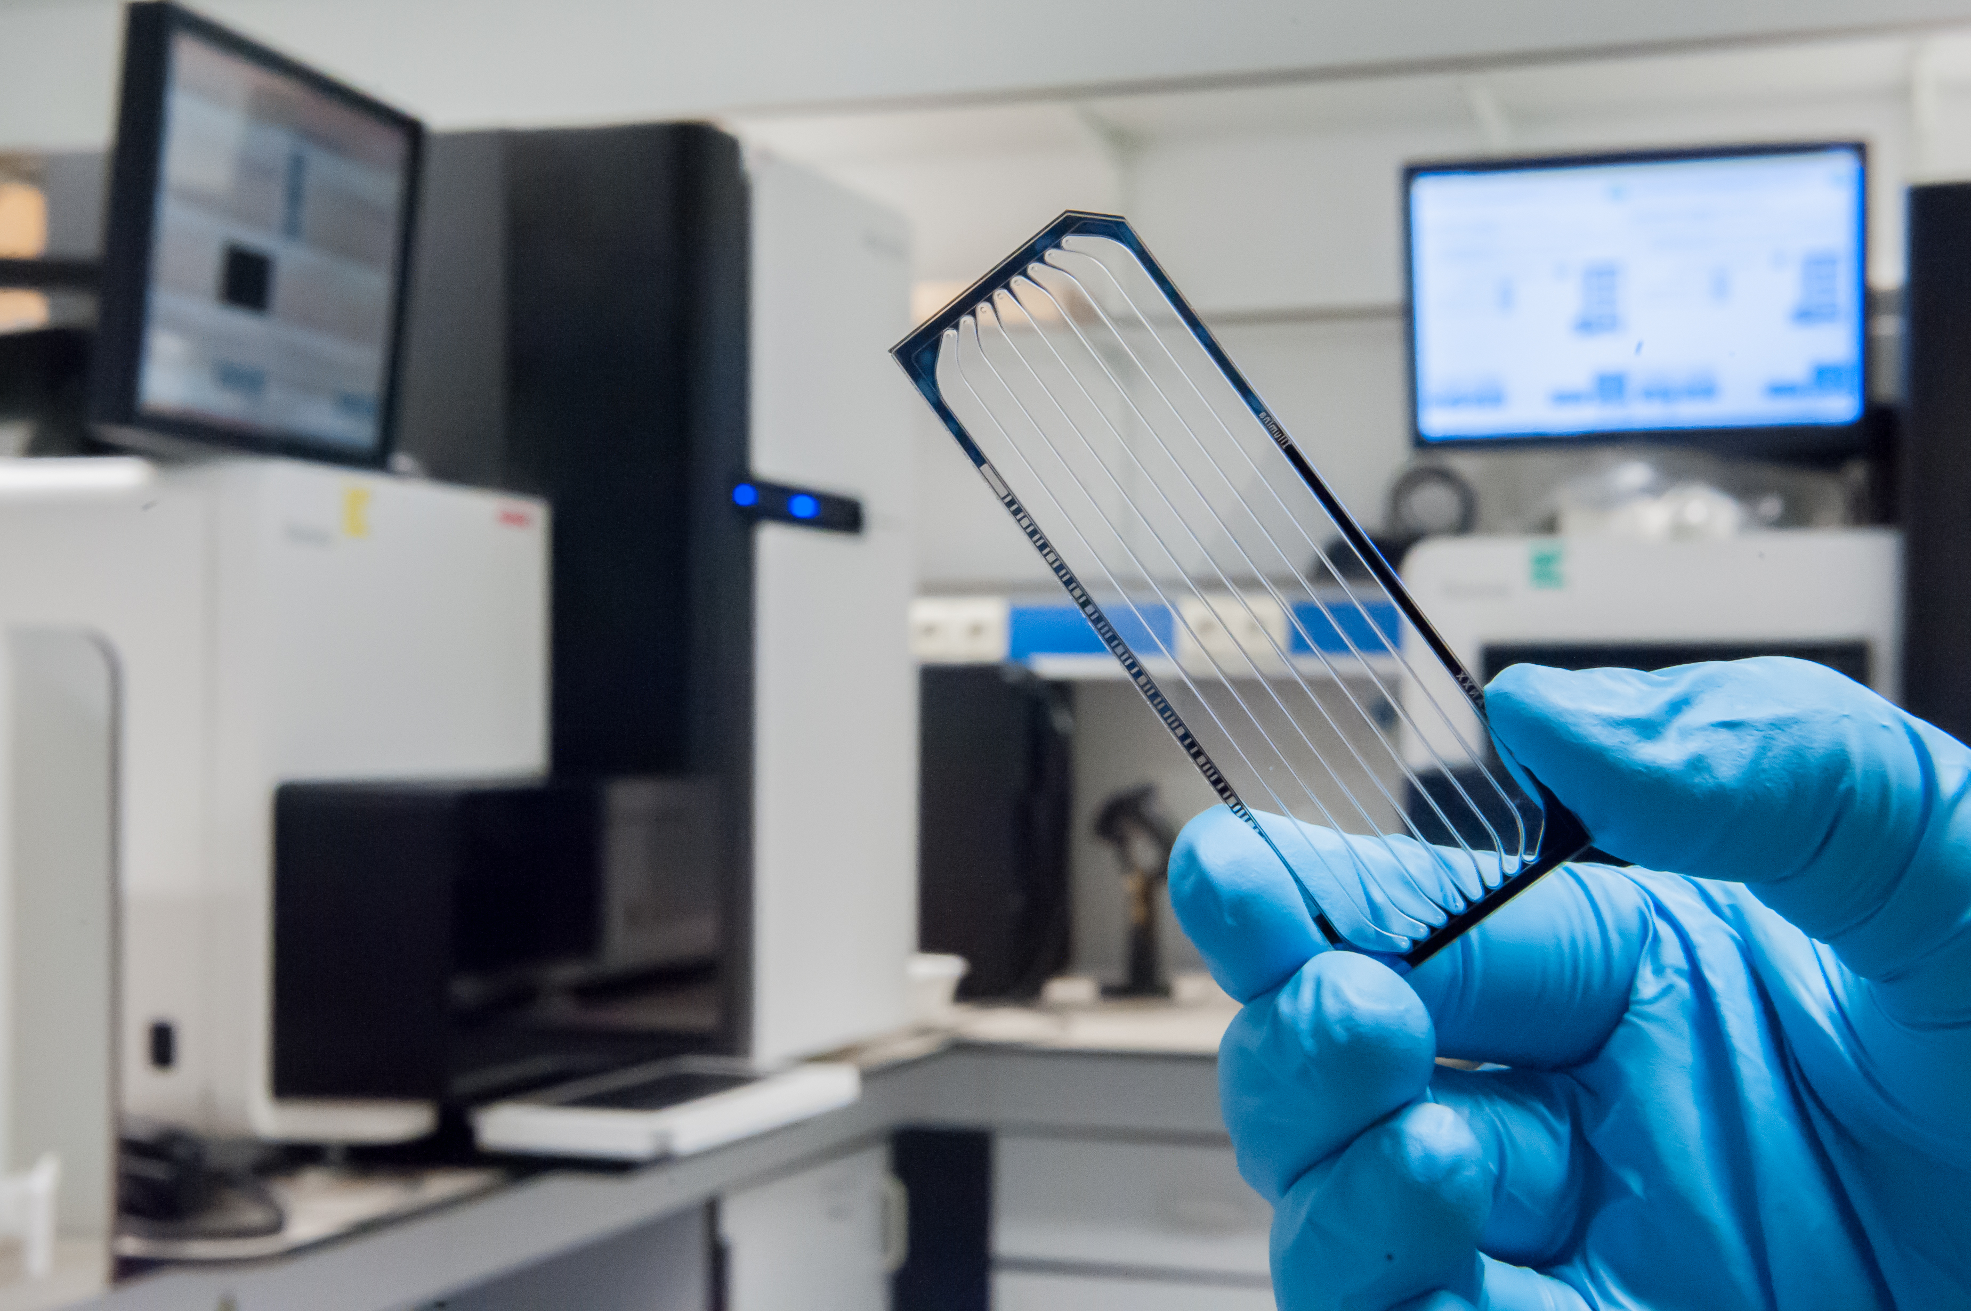

Understanding NGS raw data:
Fastq format, quality checking
Erika Souche

Slide 2
Library
Fragment
Index/barcode
Single End (SE) sequencing
Paired End (PE) sequencing
Insert size

Slide 3
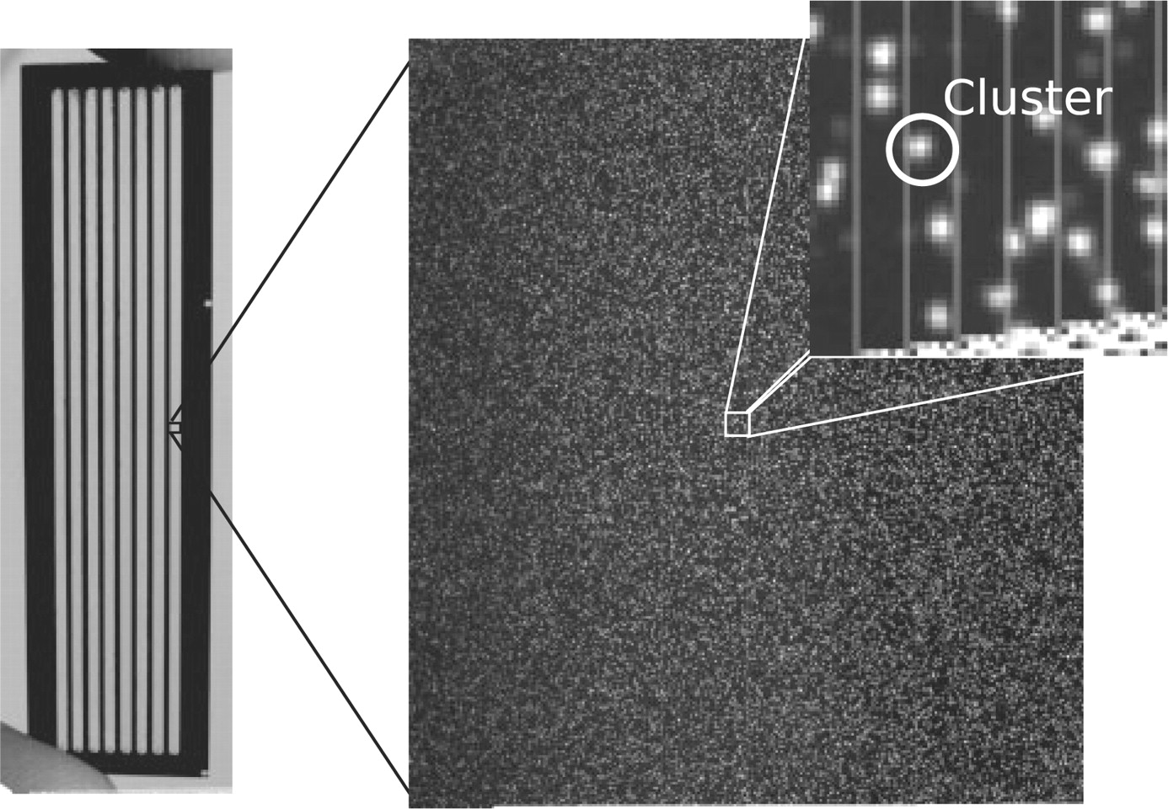
Illumina flowcell

Slide 4
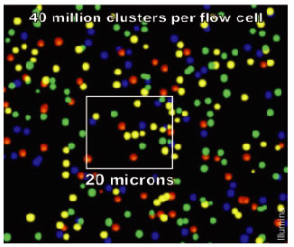
Demultiplexing
T
A
G
G
C
A
T
G
C
T
T
A
C
A
G
A
G
C
T
C
T
…

Slide 5
Demultiplexing
Read 1
Index 1
Read 1
Index 2
Read 1
Index 3
Read 1
Index 1
Read 1
Index 4
Read 1
Index 3
Read 1
Index 2
…
Sample 1
Fastq file
Sample 2
Fastq file
Sample 3
Fastq file
Sample 4
Fastq file

Slide 6
Fasta file format
>1 dna:chromosome chromosome:GRCh38:1:1:248956422:1 REF
NNNNNNNNNNNNNNNNNNNNNNNNNNNNNNNNNNNNNNNNNNNNNNNNNNNNNNNNNNNN
...
NNNNNNNNNNNNNNNNNNNNNNNNNNNNNNNNNNNNNNNNTAACCCTAACCCTAACCCTA
ACCCTAACCCTAACCCTAACCCTAACCCTAACCCTAACCCTAACCCTAACCCTAACCCTA
ACCCTAACCCTAACCCTAACCCTAACCCAACCCTAACCCTAACCCTAACCCTAACCCTAA
CCCTAACCCCTAACCCTAACCCTAACCCTAACCCTAACCTAACCCTAACCCTAACCCTAA
CCCTAACCCTAACCCTAACCCTAACCCTAACCCCTAACCCTAACCCTAAACCCTAAACCC
TAACCCTAACCCTAACCCTAACCCTAACCCCAACCCCAACCCCAACCCCAACCCCAACCC
CAACCCTAACCCCTAACCCTAACCCTAACCCTACCCTAACCCTAACCCTAACCCTAACCC
TAACCCTAACCCCTAACCCCTAACCCTAACCCTAACCCTAACCCTAACCCTAACCCTAAC
CCCTAACCCTAACCCTAACCCTAACCCTCGCGGTACCCTCAGCCGGCCCGCCCGCCCGGG
TCTGACCTGAGGAGAACTGTGCTCCGCCTTCAGAGTACCACCGAAATCTGTGCAGAGGAC
AACGCAGCTCCGCCCTCGCGGTGCTCTCCGGGTCTGTGCTGAGGAGAACGCAACTCCGCC
GTTGCAAAGGCGCGCCGCGCCGGCGCAGGCGCAGAGAGGCGCGCCGCGCCGGCGCAGGCG
CAGAGAGGCGCGCCGCGCCGGCGCAGGCGCAGAGAGGCGCGCCGCGCCGGCGCAGGCGCA
GAGAGGCGCGCCGCGCCGGCGCAGGCGCAGAGAGGCGCGCCGCGCCGGCGCAGGCGCAGA
CACATGCTAGCGCGTCGGGGTGGAGGCGTGGCGCAGGCGCAGAGAGGCGCGCCGCGCCGG
CGCAGGCGCAGAGACACATGCTACCGCGTCCAGGGGTGGAGGCGTGGCGCAGGCGCAGAG
AGGCGCACCGCGCCGGCGCAGGCGCAGAGACACATGCTAGCGCGTCCAGGGGTGGAGGCG
TGGCGCAGGCGCAGAGACGCAAGCCTACGGGCGGGGGTTGGGGGGGCGTGTGTTGCAGGA
GCAAAGTCGCACGGCGCCGGGCTGGGGCGGGGGGAGGGTGGCGCCGTGCACGCGCAGAAA
CTCACGTCACGGTGGCGCGGCGCAGAGACGGGTAGAACCTCAGTAATCCGAAAAGCCGGG
ATCGACCGCCCCTTGCTTGCAGCCGGGCACTACAGGACCCGCTTGCTCACGGTGCTGTGC
...

Slide 7
Fastq file format
Header 1
Read name
@HWI-EAS337_4_FC_3038UAAXX:1:2:1069:110/1
GATCGCCATCCAGAAATCGGTGGCTTGCTCACTTTC
+
A>AAAAAAAAAAAAAAAAAAAA>>AA*:A>A:AAA3
@HWI-EAS337_4_FC_3038UAAXX:1:2:161:1891/1
GAACTGTTGCTGGAAGACTACAAAGCCTCCCTGAAA
+
A?A4?A>A>>A?<A>AA?AA=????;??6?????=<
@HWI-EAS337_4_FC_3038UAAXX:1:2:1041:124/1
GGTGATTTCAGCCAACAGGCCAGATTGAGCGTAGCC
+
A:AAAAAAAAAAAAA=AAA=AAAAAAAA<AA=AA9=
...
Read sequence
Header 2
Read quality

Slide 8
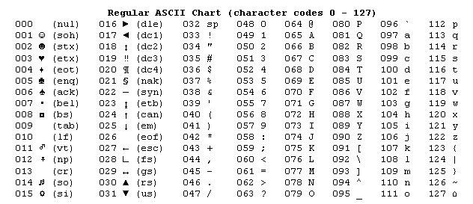
Read sequence & quality
@HWI-EAS337_4_FC_3038UAAXX:1:2:1069:110/1
GATCGCCATCCAGAAATCGGTGGCTTGCTCACTTTC
+
A>AAAAAAAAAAAAAAAAAAAA>>AA*:A>A:AAA3
Read sequence
Read quality
Phred Q =−10 log10 P
Probability of incorrect base call
1 ASCII character per base
Phred Q = dec(ASCII) – 33

Slide 9
Read sequence & quality
@HWI-EAS337_4_FC_3038UAAXX:1:2:1069:110/1
GATCGCCATCCAGAAATCGGTGGCTTGCTCACTTTC
+
A>AAAAAAAAAAAAAAAAAAAA>>AA*:A>A:AAA3
Read sequence
Read quality
Phred Q =−10 log10 P
Probability of incorrect base call
1 ASCII character per base
Phred Q = dec(ASCII) – 33
Phred Quality Score | Probability of Incorrect Base Call | Base Call Accuracy
10 | 1 in 10 | 90%
20 | 1 in 100 | 99%
30 | 1 in 1,000 | 99.9%
40 | 1 in 10,000 | 99.99%
50 | 1 in 100,000 | 99.999%

Slide 10
Demultiplexing – PE sequencing
Read 1
Index 1
Read 2
Read 1
Index 2
Read 2
Read 1
Index 3
Read 2
Read 1
Index 1
Read 2
Read 1
Index 4
Read 2
Read 1
Index 3
Read 2
Read 1
Index 2
Read 2
…
Sample 1
Fastq file R1
Sample 2
Fastq file R1
Sample 3
Fastq file R1
Sample 4
Fastq file R1
Sample 1
Fastq file R2
Sample 2
Fastq file R2
Sample 3
Fastq file R2
Sample 4
Fastq file R2

Slide 11
Fastq file format – PE sequencing
Read 1
Read 2
@HWI-EAS337_4_FC_3038UAAXX:1:2:1069:110/1
GATCGCCATCCAGAAATCGGTGGCTTGCTCACTTTC
+
A>AAAAAAAAAAAAAAAAAAAA>>AA*:A>A:AAA3
@HWI-EAS337_4_FC_3038UAAXX:1:2:161:1891/1
GAACTGTTGCTGGAAGACTACAAAGCCTCCCTGAAA
+
A?A4?A>A>>A?<A>AA?AA=????;??6?????=<
@HWI-EAS337_4_FC_3038UAAXX:1:2:1041:124/1
GGTGATTTCAGCCAACAGGCCAGATTGAGCGTAGCC
+
A:AAAAAAAAAAAAA=AAA=AAAAAAAA<AA=AA9=
@HWI-EAS337_4_FC_3038UAAXX:1:2:1114:113/1
GCTTTGTTCGTGAAGCGTTATCGCTGGTGACATGGG
+
AAAAA?AAAAA?AA?A?AAAA>>AA>A:A>>7A>>A
...
@HWI-EAS337_4_FC_3038UAAXX:1:2:1069:110/2
AACGAAGACCGCGTCGTATTGTTCCAAAAGCGAATC
+
AAAAAAAAAAAAAAAACAAAAAAAAAAAAA>>>>><
@HWI-EAS337_4_FC_3038UAAXX:1:2:161:1891/2
CAATATTTTACGTTGCTAATGACAGTGAACAGACTT
+
AAAAA>;AA6AAAA?AAAA?A&AAA<?;AA><<5;<
@HWI-EAS337_4_FC_3038UAAXX:1:2:1041:124/2
CCGGAATTAAAGTCACCGTTGAGCATCCGGATAAAC
+
AAAA;AAAAAAAAAAA?AAA=A?AAAAAAA6=>=><
@HWI-EAS337_4_FC_3038UAAXX:1:2:1114:113/2
CCGAAACAGACGCCCAGCACCCGATCGGTGCCTGAC
+
AAAAAA>AAAAAAAAAAAAAAAAAAAAA(A==6=6<
...

Slide 12
Demultiplexing statistics
RUN | MACHINE | FLOWCELL | LANE | PROJECT | SAMPLE | BARCODE | CLUSTER.COUNT | BARCODE.COUNT | BARCODE.0.MISMATCH.COUNT | BARCODE.1.MISMATCH.COUNT | BARCODE.0.MISMATCH.PERC | BARCODE.1.MISMATCH.PERC | CLUSTER.COUNT.SUM.LANE | BASECALL.COUNT | YIELD.Q30.SUM | QSUM.SUM | BASECALL.QUAL.AVG | BASECALL.QUAL.ABOVE30.PERC | CLUSTER.COUNT.PERC
191004 | HiSeq2000 | FCA | 1 | Project | GC085522 | CGCATGAT+TCAGGCTT | 5,552,039 | 5,552,039 | 5,552,039 | NA | 1 | NA | 151,682,423 | 1,121,511,878 | 1,076,542,969 | 42,813,220,820 | 38.17 | 0.96 | 0.04
191004 | HiSeq2000 | FCA | 1 | Project | GC085522_ID | CTGAAGCT+TATAGCCT | 9,777 | 9,777 | 9,777 | NA | 1 | NA | 151,682,423 | 1,974,954 | 1,913,612 | 75,745,127 | 38.35 | 0.97 | 0
191004 | HiSeq2000 | FCA | 1 | Project | GC085523 | CTTAGGAC+GTAGGAGT | 5,814,208 | 5,814,208 | 5,814,208 | NA | 1 | NA | 151,682,423 | 1,174,470,016 | 1,129,817,062 | 44,881,213,892 | 38.21 | 0.96 | 0.04
191004 | HiSeq2000 | FCA | 1 | Project | GC085523_ID | CTGAAGCT+ATAGAGGC | 17,079 | 17,079 | 17,079 | NA | 1 | NA | 151,682,423 | 3,449,958 | 3,316,987 | 131,549,660 | 38.13 | 0.96 | 0
191004 | HiSeq2000 | FCA | 1 | Project | GC085524 | ATCCGGTA+TATCGGTC | 6,290,933 | 6,290,933 | 6,290,933 | NA | 1 | NA | 151,682,423 | 1,270,768,466 | 1,221,984,994 | 48,547,800,901 | 38.20 | 0.96 | 0.04
191004 | HiSeq2000 | FCA | 1 | Project | GC085524_ID | CTGAAGCT+CCTATCCT | 14,085 | 14,085 | 14,085 | NA | 1 | NA | 151,682,423 | 2,845,170 | 2,757,522 | 109,110,362 | 38.35 | 0.97 | 0
191004 | HiSeq2000 | FCA | 1 | default | Undetermined | unknown | 11,130,696 | 712,364,544 | 712,364,544 | NA | 1 | NA | 151,682,423 | 2,248,400,592 | 2,030,960,115 | 82,104,595,067 | 36.52 | 0.9 | 0.07
SAMPLE | BARCODE | CLUSTER.COUNT | BARCODE.COUNT | BARCODE.0.MISMATCH.COUNT | BARCODE.1.MISMATCH.COUNT | BARCODE.0.MISMATCH.PERC | BARCODE.1.MISMATCH.PERC
GC085522 | CGCATGAT+TCAGGCTT | 5,552,039 | 5,552,039 | 5,552,039 | NA | 1 | NA
GC085522_ID | CTGAAGCT+TATAGCCT | 9,777 | 9,777 | 9,777 | NA | 1 | NA
GC085523 | CTTAGGAC+GTAGGAGT | 5,814,208 | 5,814,208 | 5,814,208 | NA | 1 | NA
GC085523_ID | CTGAAGCT+ATAGAGGC | 17,079 | 17,079 | 17,079 | NA | 1 | NA
GC085524 | ATCCGGTA+TATCGGTC | 6,290,933 | 6,290,933 | 6,290,933 | NA | 1 | NA
GC085524_ID | CTGAAGCT+CCTATCCT | 14,085 | 14,085 | 14,085 | NA | 1 | NA
Undetermined | unknown | 11,130,696 | 712,364,544 | 712,364,544 | NA | 1 | NA

Slide 13
Demultiplexing statistics
RUN | MACHINE | FLOWCELL | LANE | PROJECT | SAMPLE | BARCODE | CLUSTER.COUNT | BARCODE.COUNT | BARCODE.0.MISMATCH.COUNT | BARCODE.1.MISMATCH.COUNT | BARCODE.0.MISMATCH.PERC | BARCODE.1.MISMATCH.PERC | CLUSTER.COUNT.SUM.LANE | BASECALL.COUNT | YIELD.Q30.SUM | QSUM.SUM | BASECALL.QUAL.AVG | BASECALL.QUAL.ABOVE30.PERC | CLUSTER.COUNT.PERC
191004 | HiSeq2000 | FCA | 1 | Project | GC085522 | CGCATGAT+TCAGGCTT | 5,552,039 | 5,552,039 | 5,552,039 | NA | 1 | NA | 151,682,423 | 1,121,511,878 | 1,076,542,969 | 42,813,220,820 | 38.17 | 0.96 | 0.04
191004 | HiSeq2000 | FCA | 1 | Project | GC085522_ID | CTGAAGCT+TATAGCCT | 9,777 | 9,777 | 9,777 | NA | 1 | NA | 151,682,423 | 1,974,954 | 1,913,612 | 75,745,127 | 38.35 | 0.97 | 0
191004 | HiSeq2000 | FCA | 1 | Project | GC085523 | CTTAGGAC+GTAGGAGT | 5,814,208 | 5,814,208 | 5,814,208 | NA | 1 | NA | 151,682,423 | 1,174,470,016 | 1,129,817,062 | 44,881,213,892 | 38.21 | 0.96 | 0.04
191004 | HiSeq2000 | FCA | 1 | Project | GC085523_ID | CTGAAGCT+ATAGAGGC | 17,079 | 17,079 | 17,079 | NA | 1 | NA | 151,682,423 | 3,449,958 | 3,316,987 | 131,549,660 | 38.13 | 0.96 | 0
191004 | HiSeq2000 | FCA | 1 | Project | GC085524 | ATCCGGTA+TATCGGTC | 6,290,933 | 6,290,933 | 6,290,933 | NA | 1 | NA | 151,682,423 | 1,270,768,466 | 1,221,984,994 | 48,547,800,901 | 38.20 | 0.96 | 0.04
191004 | HiSeq2000 | FCA | 1 | Project | GC085524_ID | CTGAAGCT+CCTATCCT | 14,085 | 14,085 | 14,085 | NA | 1 | NA | 151,682,423 | 2,845,170 | 2,757,522 | 109,110,362 | 38.35 | 0.97 | 0
191004 | HiSeq2000 | FCA | 1 | default | Undetermined | unknown | 11,130,696 | 712,364,544 | 712,364,544 | NA | 1 | NA | 151,682,423 | 2,248,400,592 | 2,030,960,115 | 82,104,595,067 | 36.52 | 0.9 | 0.07
SAMPLE | CLUSTER.COUNT.SUM.LANE | BASECALL.COUNT | YIELD.Q30.SUM | QSUM.SUM | BASECALL.QUAL.AVG | BASECALL.QUAL.ABOVE30.PERC | CLUSTER.COUNT.PERC
GC085522 | 151,682,423 | 1,121,511,878 | 1,076,542,969 | 42,813,220,820 | 38.17 | 0.96 | 0.04
GC085522_ID | 151,682,423 | 1,974,954 | 1,913,612 | 75,745,127 | 38.35 | 0.97 | 0
GC085523 | 151,682,423 | 1,174,470,016 | 1,129,817,062 | 44,881,213,892 | 38.21 | 0.96 | 0.04
GC085523_ID | 151,682,423 | 3,449,958 | 3,316,987 | 131,549,660 | 38.13 | 0.96 | 0
GC085524 | 151,682,423 | 1,270,768,466 | 1,221,984,994 | 48,547,800,901 | 38.20 | 0.96 | 0.04
GC085524_ID | 151,682,423 | 2,845,170 | 2,757,522 | 109,110,362 | 38.35 | 0.97 | 0
Undetermined | 151,682,423 | 2,248,400,592 | 2,030,960,115 | 82,104,595,067 | 36.52 | 0.9 | 0.07

Slide 14
Fastq file quality control
How many reads do I have ?
Is that enough ?
How good is the quality of the data ?
Did I sequence what I wanted to sequence ?
Is pre-processing needed ?
….

Slide 15
Example 1 – targeted capture sequencing
Finding the genetic cause of a disease
~ 6,000 genes
Illumina PE 125 bp
Figure adapted from Nimblegen

Slide 16
Example 2 – targeted amplicon sequencing
Fingerprinting of xenocrafts
31 SNPs
Illumina PE 150 bp
Trace platform, http://www.uzleuven-kuleuven.be/lki/trace/
Figure adapted from Peter Hohenstein, EMBO Molecular Medicine: 5 (1), 2013

Slide 17
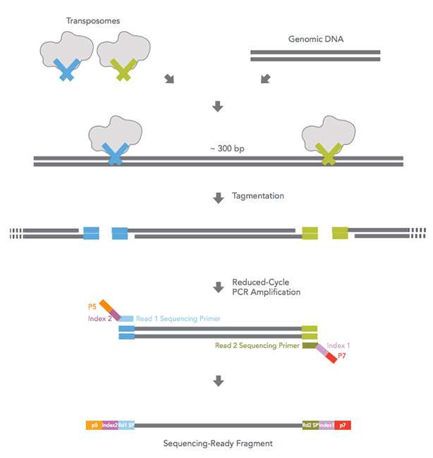
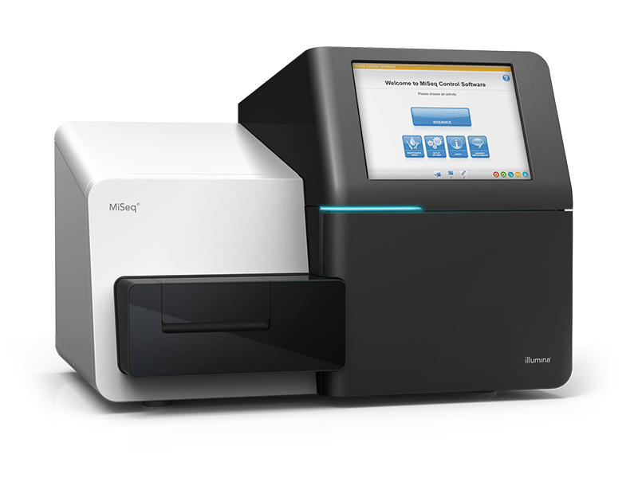
Example 3 – whole genome sequencing
Predicting bacterial resistance
Whole Genome Sequencing (WGS)
Streptococcus pneumoniae
Mycobacterium tuberculosis
Illumina PE 300 bp

Slide 18
Number of reads
Capture Sequencing (CS) Amplicon Sequencing (AS) Bacterial WGS (BWGS)
18,013,929 bp 1,835 bp 2,221,315 bp

Slide 19
Estimated coverage
Targeted Sequencing (TS) Amplicon Sequencing (AS) Bacterial WGS (BWGS)
18,013,929 bp 1,835 bp 2,221,315 bp

Slide 20
Fastq files – QC
FastQC
Check Phred quality scores
Check GC content
Check read content
…
https://www.bioinformatics.babraham.ac.uk/projects/fastqc/
https://multiqc.info

Slide 21
FastQC
Summary report
fastqc -o result sample.R1.fastq.gz
fastqc -o result sample.R2.fastq.gz

Slide 22
FastQC – Phred quality score by position
Example 1 – capture sequencing

Slide 23
FastQC – Base content by position
Example 1 – capture sequencing
G-C 25-26%
A-T 24-25%

Slide 24
FastQC – Base content by position
Example 2 – amplicon sequencing
G-C 25-27%
A-T 24-24%

Slide 25
FastQC – Over-represented sequences
Example 2 – amplicon sequencing

Slide 26
FastQC – Over-represented sequences
Example 2 – amplicon sequencing

Slide 27
Contamination check
FastQ Screen
Compare reads to various libraries
Any library can be searched against
Output proportion of reads with hit(s) to libraries
fastq_screen --subset 100000 --conf fastq_screen.conf --aligner bowtie2 --outdir result --nohits sample.R1.fastq.gz
https://www.bioinformatics.babraham.ac.uk/projects/fastq_screen/

Slide 28
Contamination check – FastQ Screen
Example 1 – capture sequencing

Slide 29
Contamination check – FastQ Screen
Example 2 – amplicon sequencing

Slide 30
Contamination check – kraken2
Taxonomic sequence classification system
Build (custom) database
Compare k-mer from reads to database
kraken2-build --download-taxonomy --db database
kraken2-build --download-library library --db database
kraken2-build --build --db database --minimizer-spaces 0
kraken2 --db database --paired sample.R1.fastq.gz sample.R2.fastq.gz –report kraken2Report.txt --use-names > kraken2.output.txt
https://ccb.jhu.edu/software/kraken2/

Slide 31
Contamination check – kraken2
Example 3 – bacterial WGS
Fragments covered by clade (%) | Fragments covered by clade | Fragments assigned to taxon | Rank code | NCBI taxonomic ID | scientific name
0.04 | 243 | 243 | U | 0 | unclassified
99.96 | 632527 | 0 | R | 1 | root
99.96 | 632527 | 0 | R1 | 131567 | cellular organisms
99.96 | 632491 | 121 | D | 2 | Bacteria
99.55 | 629954 | 1 | D1 | 1783272 | Terrabacteria group
99.53 | 629777 | 0 | P | 201174 | Actinobacteria
99.53 | 629777 | 17 | C | 1760 | Actinobacteria
99.52 | 629754 | 20 | O | 85007 | Corynebacteriales
99.52 | 629733 | 74 | F | 1762 | Mycobacteriaceae
99.51 | 629657 | 5911 | G | 1763 | Mycobacterium
98.56 | 623663 | 5295 | G1 | 77643 | Mycobacterium tuberculosis complex
97.69 | 618141 | 613920 | S | 1773 | Mycobacterium tuberculosis
0.04 | 227 | 78 | S | 78331 | Mycobacterium canettii
0.01 | 37 | 35 | S | 1768 | Mycobacterium kansasii
0.03 | 176 | 0 | P | 1239 | Firmicutes
0.03 | 176 | 0 | C | 91061 | Bacilli
0.03 | 172 | 0 | O | 186826 | Lactobacillales
0.03 | 172 | 0 | F | 1300 | Streptococcaceae
0.03 | 172 | 7 | G | 1301 | Streptococcus
0.03 | 161 | 155 | S | 1313 | Streptococcus pneumoniae
0 | 2 | 1 | S | 28037 | Streptococcus mitis
0 | 1 | 0 | S | 257758 | Streptococcus pseudopneumoniae

Slide 32
Pre-processing ?
Process fastq files prior to further analysis
Remove reads from other species
Trim adapters
Clip low quality bases
Merge overlapping reads from same fragment
...

Slide 33
Adapter clipping & trimming
FastqMcf
Detect & remove sequencing adapters and primers
Detect & clip poor quality at the ends of reads
Remove low complexity reads
Detect & remove Ns from ends of reads
Keep PE reads in right order
fastq-mcf -H -X -o sample_filtered.R1.fastq.gz -o /sample_filtered.R2.fastq.gz adapters.fa sample.R1.fastq sample.R2.fastq
https://github.com/ExpressionAnalysis/ea-utils/blob/wiki/FastqMcf.md

Slide 34
Adapter clipping & trimming – FastqMcf
Example 2 – amplicon sequencing
Input
2 fastq files of 1,834 reads each
Outputs
2 fastq files of 1,801 reads each
List of adapter found
Adapter TruSeq_Adapter,_Index_1 : counted 1038 at the 'end' of 'sample.R1.fastq’
…
Adapter Illumina_Single_End_Sequencing_Primer_3p : counted 1046 at the 'end' of 'sample.R2.fastq’
…
Total reads: 1801
Too short after clip: 33

Slide 35
Adapter clipping & trimming – FastqMcf
Example 2 – amplicon sequencing

Slide 36
Read selection – Kraken 2 & seqtk
Select reads from sequenced organism
Kraken2 outpout
Seqtk: toolkit for processing sequences in FASTA/Q formats
grep ”organism” kraken2.output.txt | cut –f2 > reads.list
seqtk subseq sample.R1.fastq.gz reads.list | gzip - > sample.selected.R1.fastq.gz
seqtk subseq sample.R2.fastq.gz reads.list | gzip - > sample.selected.R2.fastq.gz
https://ccb.jhu.edu/software/kraken2/
https://github.com/lh3/seqtk

Slide 37
Merge overlapping reads – FLASH2
FLASH (Fast Length Adjustment of SHort reads)
Merge paired-end reads
Keep DNA insert only
flash2 --max-overlap=250 --min-overlap=20 --allow-outies -d result -o sample.flashed sample.R1.fastq.gz sample.R2.fastq.gz > flash.log
https://github.com/dstreett/FLASH2

Slide 38
Merge overlapping reads – FLASH2
FLASH (Fast Length Adjustment of SHort reads)
Merge paired-end reads
Keep DNA insert only
flash2 --max-overlap=250 --min-overlap=20 --allow-outies -d result -o sample.flashed sample.R1.fastq.gz sample.R2.fastq.gz > flash.log
https://github.com/dstreett/FLASH2

Slide 39
Questions?
Erika Souche

Slide 40
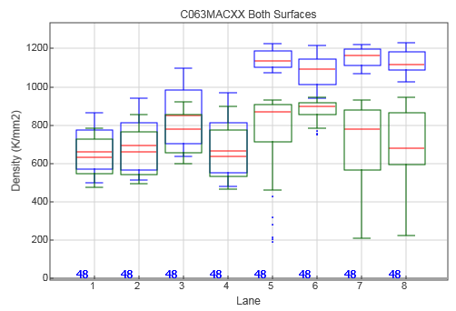
Cluster density

Slide 41
Demultiplexing
Read 1
Index 1
Read 1
Index 2
Read 1
Index 3
Read 1
Index 1
Read 1
Index 4
Read 1
Index 3
Read 1
Index 2
…
Sample 1
Sample 2
Sample 3
Sample 4

Slide 42
Demultiplexing
Read 1
Index 1
Read 2
Read 1
Index 2
Read 2
Read 1
Index 3
Read 2
Read 1
Index 1
Read 2
Read 1
Index 4
Read 2
Read 1
Index 3
Read 2
Read 1
Index 2
Read 2
…
Sample 1
Sample 2
Sample 3
Sample 4

